Slide 1


Xiaoguang Mo Lin Wang

Slide 2
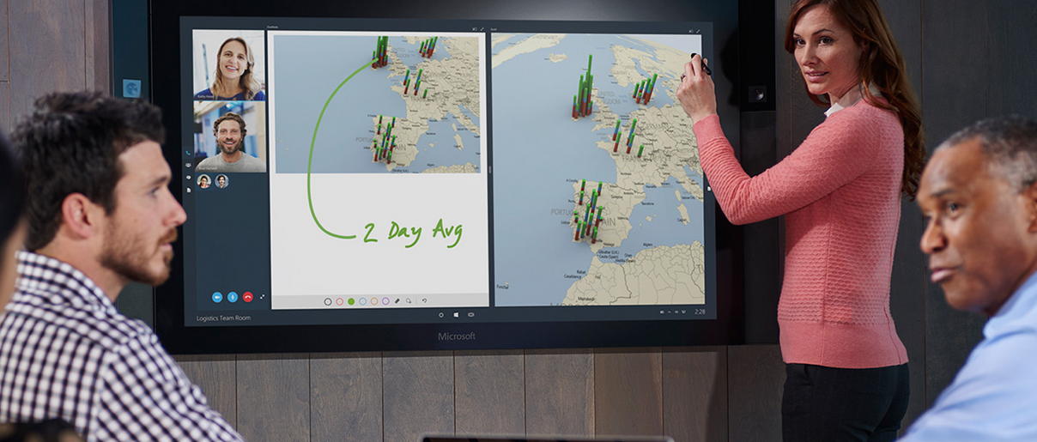
Microsoft Surface Hub

Slide 3

Traditional note taking

Slide 4
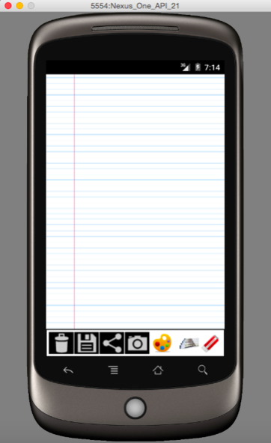
KeepNote

Slide 5
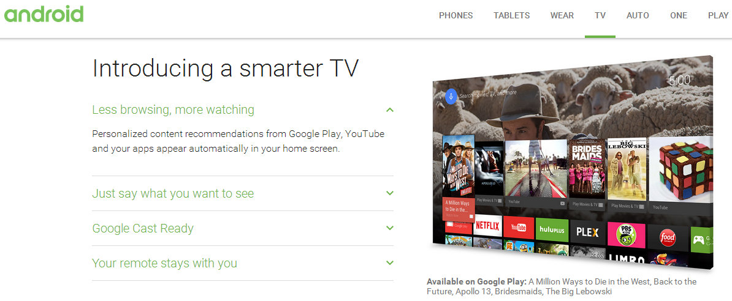
Android TV

Slide 6
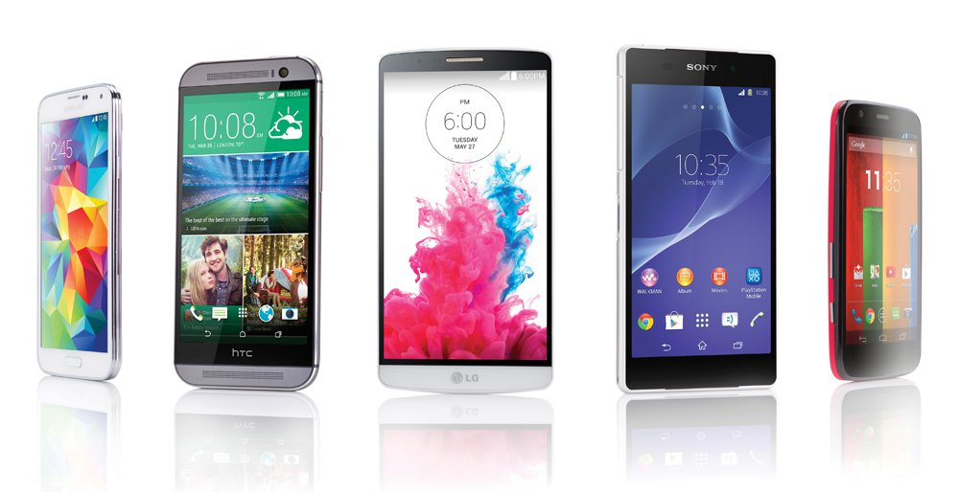
Mobile device

Slide 7

Why?
Main features

Slide 8

The end Thank you
S
W
O
T
Previous Android develop experience
There are lots of similar application on the market. How do we stand out?
If we can have our own feature and accomplish it by coding
Some feedback from the customer. e.g. we cannot create a new page of the KeepNote, however, we can have similar functionality

